Slide 1

An case study on Virtual Memory Strategies
in Modern OS
Group 6

Slide 2
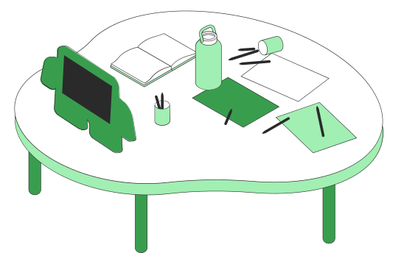
What is Financial Technology or FinTech?
Banking Before and After FinTech
A Brief history of FinTech
Challenges of FinTech
Rewards of FinTech-driven Payments
What's Next for FinTech?
FinTech 101
What to Know

Slide 3
Introduction to Virtual Memory
Virtual memory is a memory management technique used by operating systems to simulate more RAM than is physically available. It allows programs to use more memory than is actually installed on the computer by temporarily transferring data from RAM to disk storage. This allows the computer to run programs that require more memory than is physically available, improving overall system performance.

Slide 4

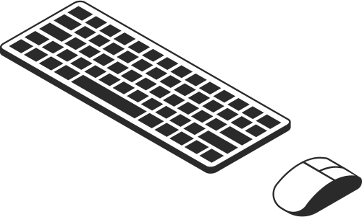
INTRODUCTION
Virtual memory is a memory management technique used by operating systems to simulate more RAM than is physically available. It allows programs to use more memory than is actually installed on the computer by temporarily transferring data from RAM to disk storage. This allows the computer to run programs that require more memory than is physically available, improving overall system performance.
Modern operating systems play a crucial role in computing by providing a platform for applications to run and managing hardware resources efficiently.
Resource Management, Security, Multi-tasking, File Management
Studying virtual memory strategies in modern operating systems is important for optimizing performance, managing resources efficiently, and enhancing system reliability and security.

Slide 5


Banking Before FinTech
Banking
with FinTech
Long queues at banks
Manual transfer of payments
A ton of paperwork is involved
People can track how their money moves in real-time
Online banking is available 24/7
Users can transfer the money instantaneously through banking apps

Slide 6
A brief history of FinTech
1838
1950
1982
2009
2013
The electric telegraph was introduced for
the first time.
Diner's Club released the
first universal credit card.
The world was introduced to TradePlus, the online brokerage platform.
The first version
of Bitcoin was released.
Google Pay was first launched, followed by Apple Pay in 2014.
Arner, Douglas. “The Evolution of Fintech: A New Post-Crisis Paradigm? By Douglas W. Arner, Janos Nathan Barberis, Ross P. Buckley :: SSRN.” Social Science Research Network, 1 Oct. 2015, papers.ssrn.com/sol3/papers.cfm?abstract_id=2676553. Accessed 5 Apr 2021.

Slide 7
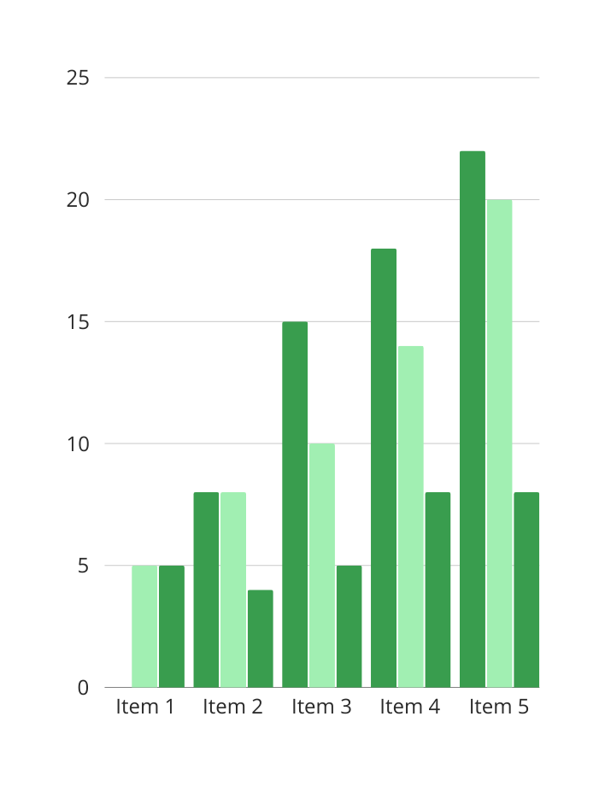
FinTech segments according to transaction value
As of January 2021
Digital payments are leading the way followed by personal finance, alternative lending, and alternative financing.

Slide 8

The Role of Cybersecurity
in FinTech
Protecting data is crucial
Because there's a lot of sensitive information involved in banking, cybersecurity is non-negotiable. Financial institutions must have robust cybersecurity measures to protect the data of consumers.

Slide 9


Challenges of FinTech

Slide 10
Where Fintech is now
Fintech-related Apps | Solutions They Offer
Payment Apps | These apps ease the payment experience of consumers and business owners alike
Investment Apps | These apps provide an easy and simple avenue for individuals to invest in stocks directly from your personal phones
Crypto Apps | These type of online apps allow individuals to use cryptocurrencies and tokens in transactions
Highlight two or more cells, right-click then choose "Merge Cells" to organize your table according to your needs!

Slide 11



Top Trending FinTech Risks
Dangers posed by FinTech to consumers
Money laundering risk
Online hacking
Digital identity risks
Regulations are yet
to be improved.
Hackers can gain access
to your accounts.
Security codes and passwords could be easily accessed.

Slide 12



Rewards
of FinTech-driven payments
Greater speed
Instant transfer of funds
Enhanced transparency
There's a clear trail of where money goes
Better security
A closer look at the benefits of
FinTech-powered payments
You can rest assured that your money
will not go astray

Slide 13

What's next for FinTech?
Looking forward to the future
Artificial intelligence and machine learning
will further infiltrate and improve FinTech.

Slide 14

FinTech has transformed the banking industry for the better.

Slide 15

Next-level data protection and encryption
Secure code and architecture
Secure authentication
Good mobile encryption
Compliance
Security best practices of successful FinTech projects

Slide 16


Financial institutions must be able to deliver an easy to navigate, a seamless digital platform that goes far beyond a miniaturized online banking offering.
Jim Marous

Slide 17
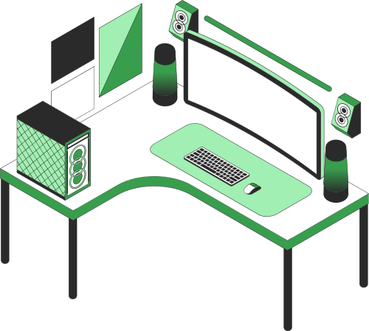
Do you have any questions?
Send it to us! We hope you
learned something new.

Slide 18





Whiteboard Page
Write a note here
Write a
note here
Tip: Collaboration makes teamwork easier! Click "Share" and invite your teammates to fill this up. Use this page for bulletins, brainstorms, and other fun team ideas.
Right-click on the background of the slide, or on the thumbnail below, for the option to expand this page into a whiteboard for more space!
Copy a note, drag to the board, and write your ideas.
Copy a note, drag to the board, and write your ideas.

Slide 19
Add even more sub-ideas
Add more sub-ideas
Add even more sub-ideas
Collaborate on a Whiteboard
Add a related idea
Add more sub-ideas
Add a main topic
Add a related idea
Add a related idea
Tip: Collaboration makes teamwork easier! Click "Share" and invite your teammates to fill this up. Use this page for bulletins, brainstorms, and other fun team ideas.
Right-click on the background of the slide, or on the thumbnail below, for the option to expand this page into a whiteboard for more space!
Add a related idea
Add more sub-ideas
Add even more sub-ideas
Add more sub-ideas
Add even more sub-ideas

Slide 20



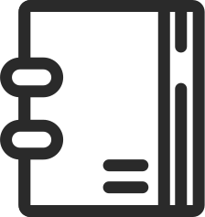


























Resource Page
Use these design resources in your
Canva Presentation. Happy designing!
Don't forget to delete or hide this page before presenting.

Slide 21
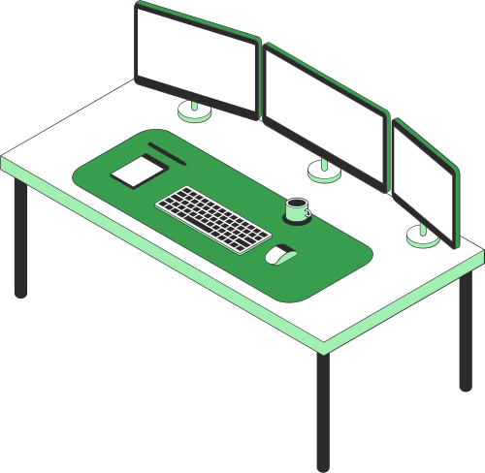
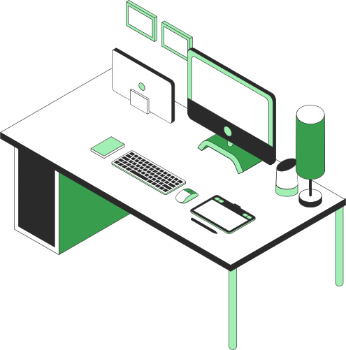

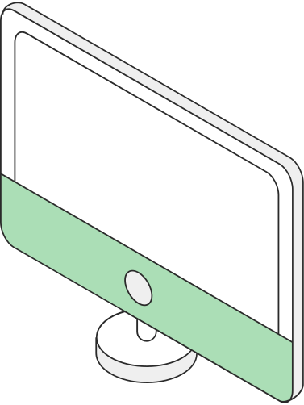
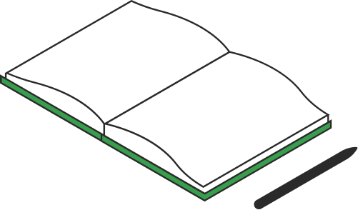
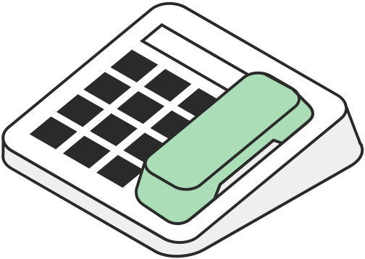
Resource Page
Use these design resources in your
Canva Presentation. Happy designing!
Don't forget to delete or hide this page before presenting.

Slide 22









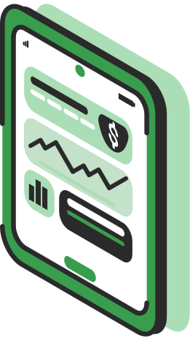

Resource Page
Use these design resources in your
Canva Presentation. Happy designing!
Don't forget to delete or hide this page before presenting.

Slide 23
B for blur | C for confetti
D for a drumroll | M for mic drop
O for bubbles | Q for quiet
U for unveil | Any number from 0-9 for a timer
Resource Page
Find the magic and fun in presenting with Canva Presentations. Press the following keys while on Present mode!
Delete or hide this page before presenting.

